Slide 1

SMART RECRUITMENT
ASSISTANT
AI-Powered Candidate Screening & Ranking
Graduation Project
TEAM MEMBERS
• Sama Abdelsalam • Yasseen Mohamed• Bassem Yasser
• Mohamed Ali • Mazen Mohamed
Instructor: Dr. Raheeq Ayman
Smart Recruitment Assistant

Slide 2
Problem
02
01 Training Investment
02 MANUAL WORK
03 PRIORITY
04 DATA
Large numbers of candidate profiles can make initial screening time-consuming.
Manual review may require significant effort and consistent criteria.
Recruiters need a way to prioritize candidates for further review.
Use machine learning to provide a data-driven screening signal.
Goal: Support recruiters — not replace human decisions.
Smart Recruitment Assistant

Slide 3
Dataset
03
HR Analytics: Job Change of Data Scientists
20,000+
14
8000+
3.01
Training records
Original features
Null rows detected
Approx. class imbalance ratio
Examples of features
Education • Experience • Company Information • City • Training Hours • Gender
Target: Job Change / No Job Change
Smart Recruitment Assistant

Slide 4
Approach
04
01
02
03
04
05
06
EDA
Data Cleaning
Feature Encoding
Model Training
Evaluation
Candidate Ranking
Models
Logistic Regression • Random Forest • XGBoost
Stratified 5-Fold Cross Validation + Hyperparameter Tuning
Smart Recruitment Assistant

Slide 5
Dataset Preprocessing
05
01 Data Cleaning & Feature Transformation
Missing Value Imputation
We Filled missing numerical fields using the Median and missing categorical values with the label "Unknown".
Machine learning algorithms cannot handle null/blank cells.
The Median was selected because it is robust against skewed distributions and extreme outliers (such as high training hours).
The "Unknown" label treats missing categorical information as a distinct, potentially meaningful behavioral signal.
02 Categorical Encoding
Converted text attributes into numerical values using Ordinal Mapping (e.g., Education Level, Experience) and One-Hot Encoding (e.g., Gender, Major Discipline).
Ordinal Encoding preserves the natural ranking and hierarchy between levels (e.g., Ph.D. > Masters > Graduate).
One-Hot Encoding creates independent binary columns to prevent models from assuming a false numeric order among nominal categories

Slide 6
Scaling, Selection & Pipeline Integration
05
01 Data Cleaning & Feature Transformation
Feature Standardization
Applied StandardScaler to all numerical inputs to normalize their mean to 0 and variance to 1
Variables existed on vastly different scales (e.g., City Development Index from 0 to 1 vs. Training Hours up to 300+). Scaling prevents high-magnitude features from disproportionately dominating model weights.
02 Feature Selection & Pipeline Encapsulation
Used SelectFromModel with a tree-based estimator to drop the bottom 50% least informative features, bundling all preprocessing and model steps into a scikit-learn Pipeline.
Feature Selection eliminates noise created by wide one-hot expansions, preventing overfitting and speeding up convergence.
The Pipeline guarantees strict Data Leakage Prevention by ensuring transformations are learned solely within training folds during cross-validation

Slide 7
Results
06
ROC-AUC Comparison
Logistic Regression
0.7702
Random Forest
0.8006
XGBoost
0.8031
RECALL
F1-SCORE
BEST MODEL
0.8150
0.8534
XGBoost
Smart Recruitment Assistant

Slide 8
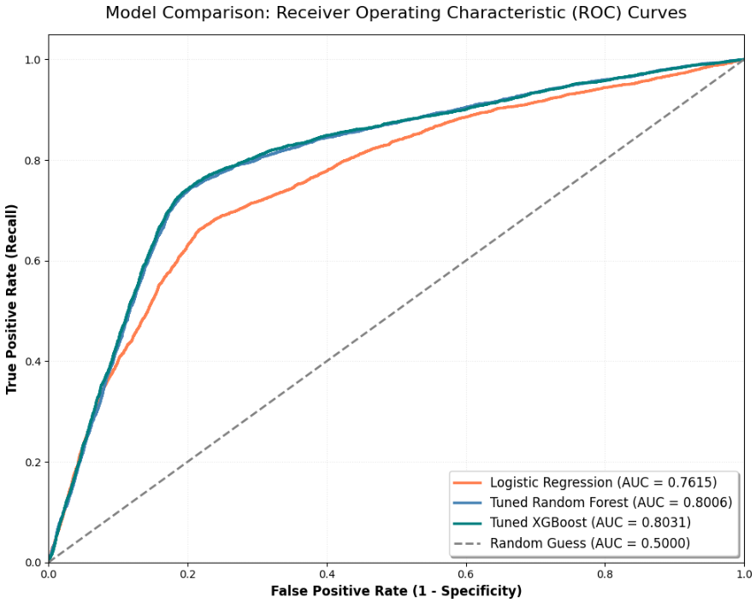
Results
07
ROC-AUC Comparison
Smart Recruitment Assistant

Slide 9
Business Impact
08
SAVE TIME
PRIORITIZE
DATA-DRIVEN
HUMAN IN LOOP
Reduce effort during initial candidate screening.
Rank candidates using model probability scores.
Provide a measurable screening signal.
Support recruiters; final decisions remain human.
Smart Recruitment Assistant

Slide 10
Conclusion
09
End-to-End Machine Learning Recruitment Workflow
Data → EDA → Preprocessing → Modeling → Best Model: XGBoost → Evaluation → Candidate Ranking
BEST ROC-AUC
BEST RECALL
BEST F1
0.8031
0.8150
0.8534
Thank You
Smart Recruitment Assistant

